Slide 1



Compressive strength of concrete using (LC3 + Nano-Bubble)
CP302 Project
Civil Department
AYUSHI BHARADIA – 2021CEB1014
DEVESH KUMAR MAHAR – 2021CEB1018
PRIYA MEENA - 2021CEB1027
YASH KUMAR – 2021CEB1035
Instructor – Dr. Muthulingam Subramaniyan

Slide 2


Table of Contents
Introduction
Objective
Methodologies
Results
Observations
Conclusion
Future Work
Refrences
Contribution

Slide 3
Objective
• To evaluate the compressive strength of concrete made with LC3 (limestone calcined clay cement) using nanobubble water.
• To compare the compressive strength of concrete made with LC3 and distilled water.
** To analyze the performance variations between LC3 and OPC concrete with nanobubble and distilled water. {from previous batch data)

Slide 4
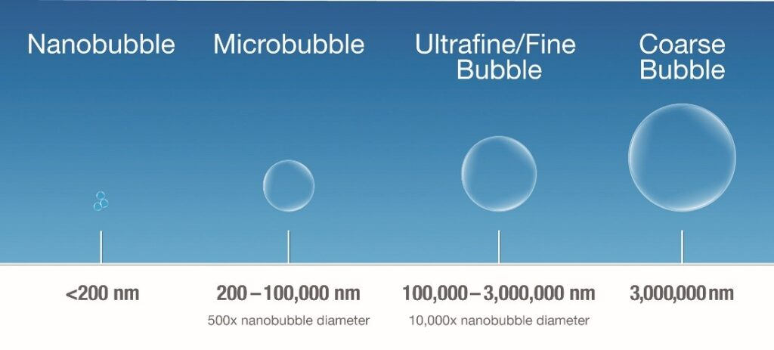
Introduction of Nano Bubble
Nanobubble water which are tiny air bubbles (less than 200 nanometers in diameter).
Nano bubbles penetrates the concrete, increasing the available water for cement hydration at the microscopic level, resulting in chemical reaction between water and cement particles.
In LC3, kaolinite, when combined with lime from cement, undergoes a reaction to produce calcium silicate hydrates (C-S-H), and the presence of nanobubbles enhances this reaction, leading to a denser microstructure, stronger, and more durable concrete.
Sources-google

Slide 5
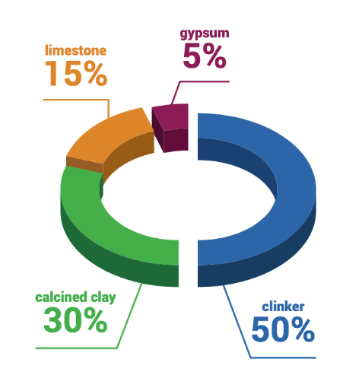
LC-3 Cement
LC3 = Calcined clay + clinker + Limestone + Gypsum Here we are using combination LC2 (25%) + OPC (75%)
We have preferred Limestone Calcined Clay Cement (LC3) over other cement due to following perks:-
LC3 significantly reduces CO2 emissions compared to traditional Portland cement.
Limestone and calcined clay combination in LC3 improves the mechanical properties and durability of the cement.
Cost-effective as it uses abundant and low-grade raw materials.

Slide 6
Methodology
1.) CONSISTENCY TEST​
This test helps us to determine the amount of water needed to create a cement paste with a specific consistency.
2.) INITIAL & FINAL SETTING TIME
Initial Setting Time - The time from adding water to the cement until it begins to lose plasticity and starts hardening.​
Final Setting Time - The time from adding water until the cement has completely lost plasticity and has achieved its initial hard form.​
​

Slide 7
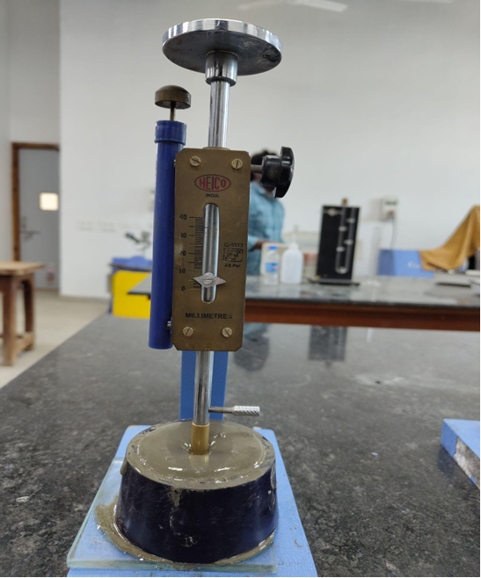
Standard Consistency Test (NBW)
P% | Amount of Water (in ml) | Depth of penetration (mm)
32 | 96 | 25
34 | 102 | 12
35 | 105 | 8
36 | 108 | 6
When the plunger penetrate the paste to a distance of 5 to 7 mm from the bottom of the mould that is standard consistency

Slide 8
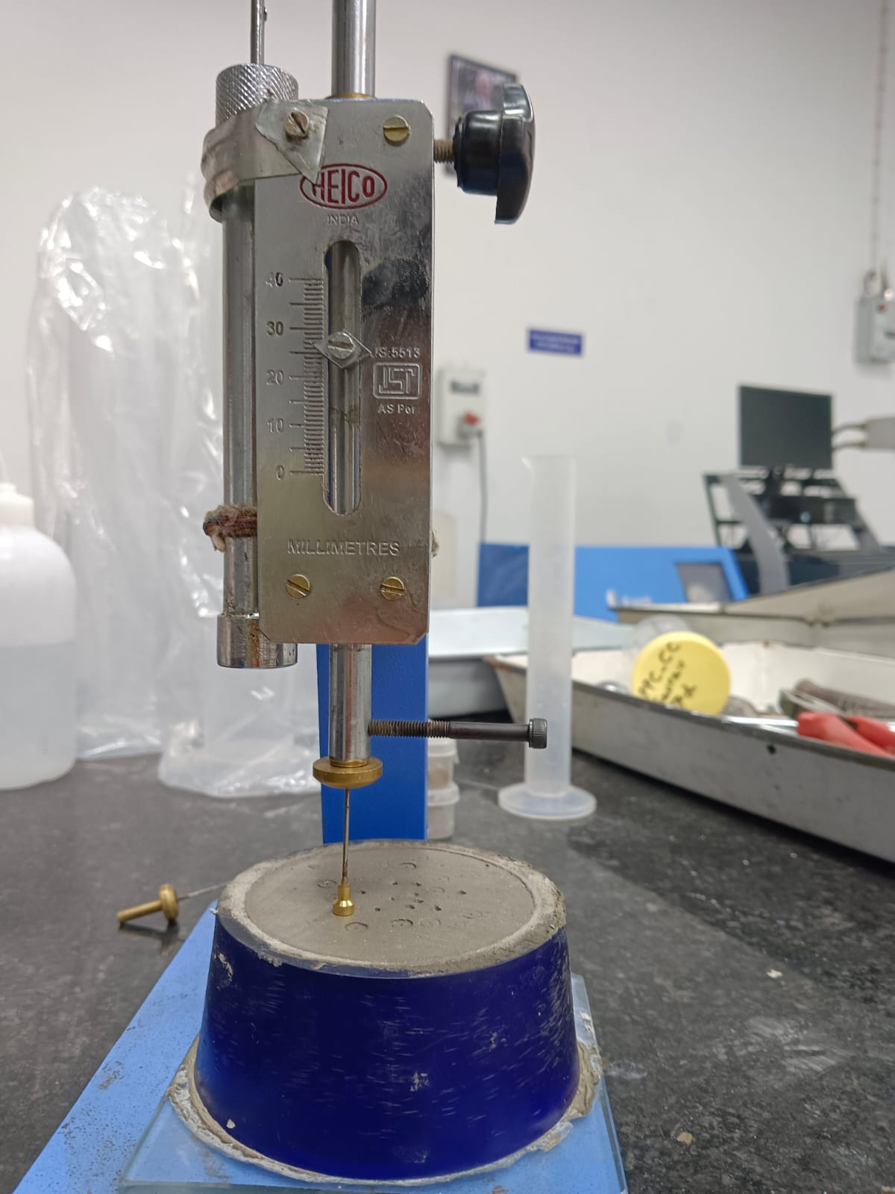
Initial and Final Setting Time Test
Sample | Initial Setting Time | Final Setting Time
Distilled Water | 1 hr 31 min | 4 hr 27 min
Nano-Bubble Water | 88 min | 4 hr 46 min
Initial setting time - the time between adding water to the cement when a 1 mm needle can't penetrate the cement paste by 5 + 0.5 mm.
Final setting time - the time between adding water and when a 5 mm hollow circular needle can't make an impression on the mold
​

Slide 9
Methodology
Material Selection: We have collected Nanobubble from chemical Department.
Mix Design: Developed concrete mix using LC3 cement and Nanobubble water. This involves proportions of cement, aggregates, and Nanobubble water.
Preparation and Mixing: Prepared the concrete mix by thoroughly blending the components. Ensure uniform dispersion of nanoparticles to avoid clustering, which can negatively impact the concrete’s properties.
Casting : Casted the concrete into moulds under controlled conditions.
5.Testing: Conduct compressive strength tests on the cured concrete specimens.
Cubes will be tested in format of time span of 7days, 14 days, 28 days, 56 days for taken concentration.

Slide 10
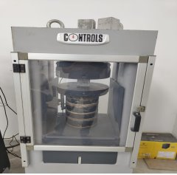
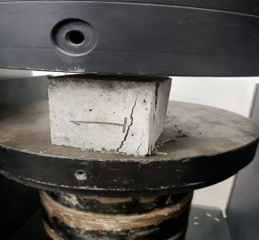
Compressive Strength Test
It is a standard procedure used to determine the maximum compressive load a material can withstand before failure, typically in the form of crushing or collapsing
Composition of mixture
1 : 3
Cement (200g)
Sand (600g)
OPC (150g)
LC-2 ( 50g)
I (200g)
II (200g)
III (200g)
{ Amount of water = (0.25 C +3) % of Total wt. of mixture } where c=consistency

Slide 11
Data of Compressive strength (in MPa)
Days | Sample | S-1 | S-2 | S-3
7 | DW | 32.91 | 40.05 | 34.32
 | NBW | 37.09 | 34.37 | 33.97
14 | DW | 44 | 46.51 | 45.72
 | NBW | 43.48 | 47.25 | 45.13
28 | DW | 46.10 | 49.12 | 38.59
 | NBW | 46.04 | 45.48 | 47.99
DW= Distilled water
NBW= Nanobubble water
All Values are in MPa

Slide 12
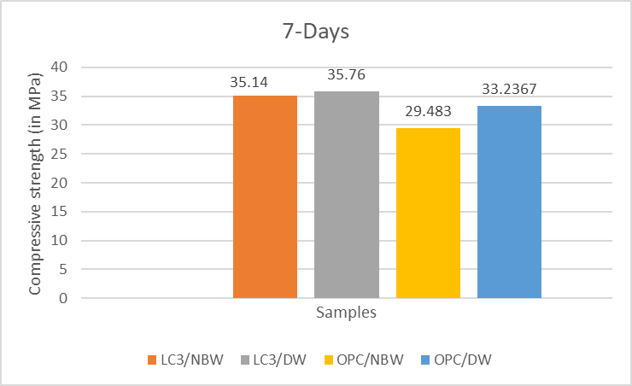
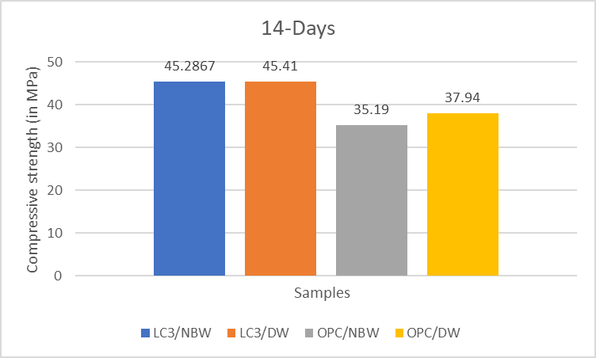
Graphs
OPC used for comparison is OPC 43

Slide 13
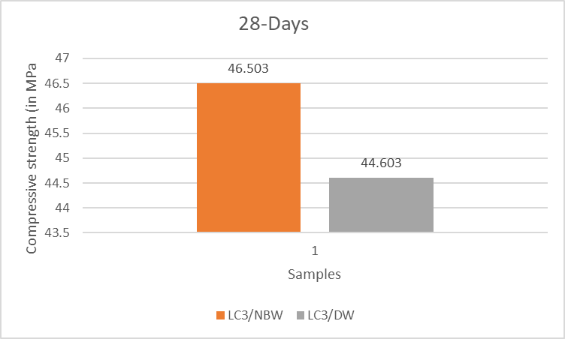
Graphs

Slide 14
Microstructure Properties
1.) X-ray Diffraction (XRD): X-ray diffraction (XRD) is a technique used to study the crystalline phases of concrete and other construction materials.
Like in OPC the crystalline phases involved are alite (C3S), belite (C2S).
Like in LC3 the crystalline phases involved are quartz, kaolinite, or metakaolin, and sometimes calcite.
2.) Fourier-transform Infrared Spectroscopy (FTIR): Identifying chemical bonds and functional groups within materials .
Like in LC3 limestone is present so this test will detect Carbonate groups (CO₃²⁻).
similarly in calcined clay , alumina-silicate are present so we detect these bonds.

Slide 15
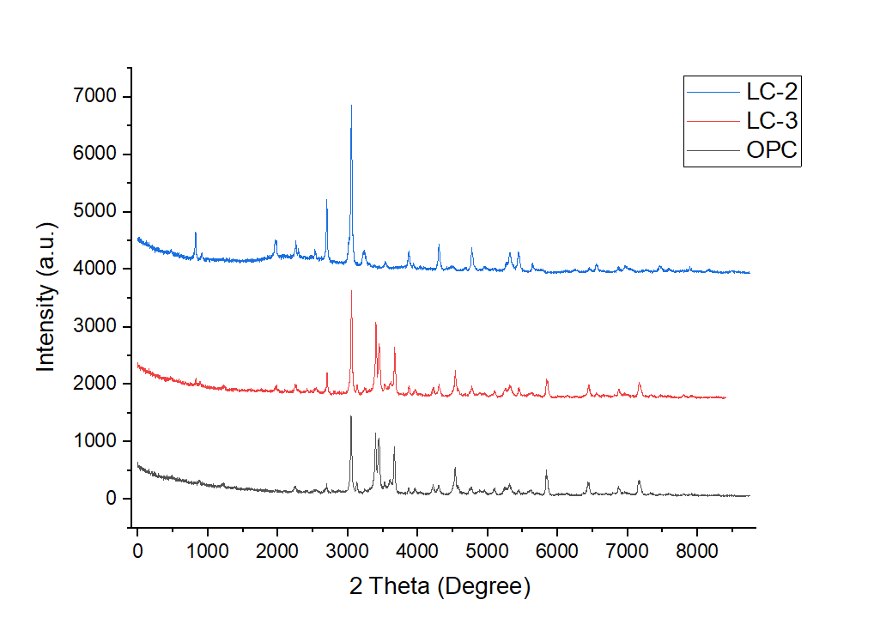
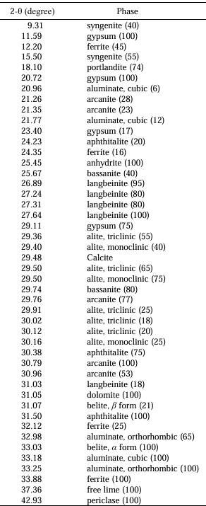
XRD Graph

Slide 16
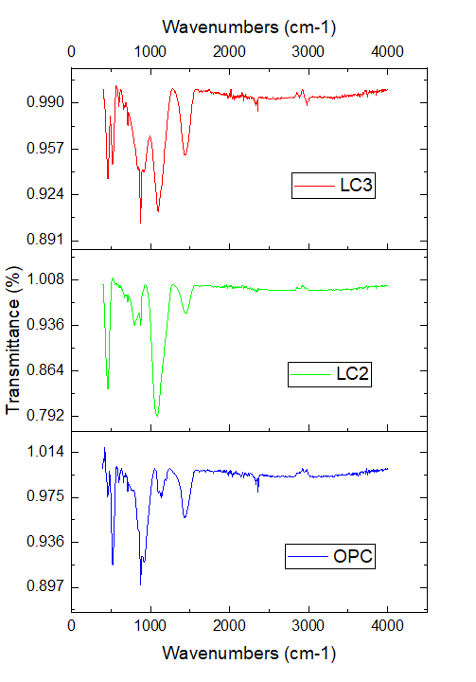
FTIR Graph
Fingerprint region carbonates O-H (rep. Silicates)

Slide 17
Observations
LC3 ?
1.) Cost 2.) environmentally sustainable {*low c emissions) Nano Bubble Water ?
1.) The compressive strength results showed no significant improvement over distilled water, and further long-term studies are needed like 56 days testing
The combination of LC3 cement and nanobubble water could represent a promising solution as this is cost-effective also provided that further research confirms the long-term performance.
** The main objective of determining whether compressive strength would increase with these innovations was achieved, while the immediate results did not show an increase, long-term gains with nanobubble water still warrants further investigation.

Slide 18
Conclusion
Standard Consistency= 36% (for Nano bubble water )
Initial & Final setting time
Compressive strength- strength is coming nearly same both the cases , after 56 days testing we will observe a change preferably in Nanobubble case due to reaction of kaolinite with Nano bubble water.
Sample | Initial Setting Time | Final Setting Time
Distilled Water | 1 hr 31 min | 4 hr 27 min
Nano-Bubble Water | 88 min | 4 hr 46 min

Slide 19
Future work
56 Days Testing
TGA analysis

Slide 20
References
https://www.sciencedirect.com/science/article/pii/S2352710218312828?via%3Dihub
https://www.sciencedirect.com/science/article/pii/S0950061823041193?via%3Dihub
https://www.sciencedirect.com/science/article/pii/S0950061820313313?via%3Dihub
https://www.sciencedirect.com/science/article/pii/S0008884617308360?via%3Dihub
Google
For XRD & FTIR- http://dx.doi.org/10.6028/jres.121.004 For Nanobubble porperties- https://docs.google.com/spreadsheets/d/1D62y6aHWBLVROjTLcCyZybRb4PyVr9e0c-bDtWodyCo/edit?usp=sharing

Slide 21
Contributions
Group Members | Contribution
Ayushi Bharadia (2021CEB1014) | Testing Casting of Cubes
Devesh Kumar (2021CEB1018) | Testing Casting of Cubes Software Work
Priya Meena (2021CEB1027) | Testing Casting of Cubes
Yash Kumar Azan (2021CEB1035) | Testing Casting of Cubes Software Work

Slide 22


